Slide 1

Customer Shopping Behavior Analysis
Presented by Suhail
3,900 purchases — 18 columns. Goal: uncover spending patterns, segments, preferences, subscriptions.

Slide 2

Dataset Summary
Size
Key Features
Missing Data
Rows: 3,900 · Columns: 18
Demographics, purchase details, behavior, shipping, discounts
37 nulls in Review Rating

Slide 3

Exploratory Data Analysis (Python)
Load & Inspect
pandas: df.info(), .describe()
Clean & Impute
Imputed Review Rating by category median
Engineer Features
age_group, purchase_frequency_days
DB Load
Exported cleaned DF → MySQL

Slide 4


Revenue by Gender
Male: 157,890 · Female: 75,191
Clear skew toward male spending

Slide 5

Discount Behavior
High-Spending Discount Users
Examples: customer 4 spent 90, customer 9 spent 97
Top Discounted Items
Hat 50% · Sneakers 49.66% · Coat 49.07% · Sweater 48.17% · Pants 47.37%

Slide 6

Top Rated Products
Gloves 3.86 · Sandals 3.84 · Boots 3.82 · Hat 3.80 · Handbag 3.78 · Skirt 3.78

Slide 7
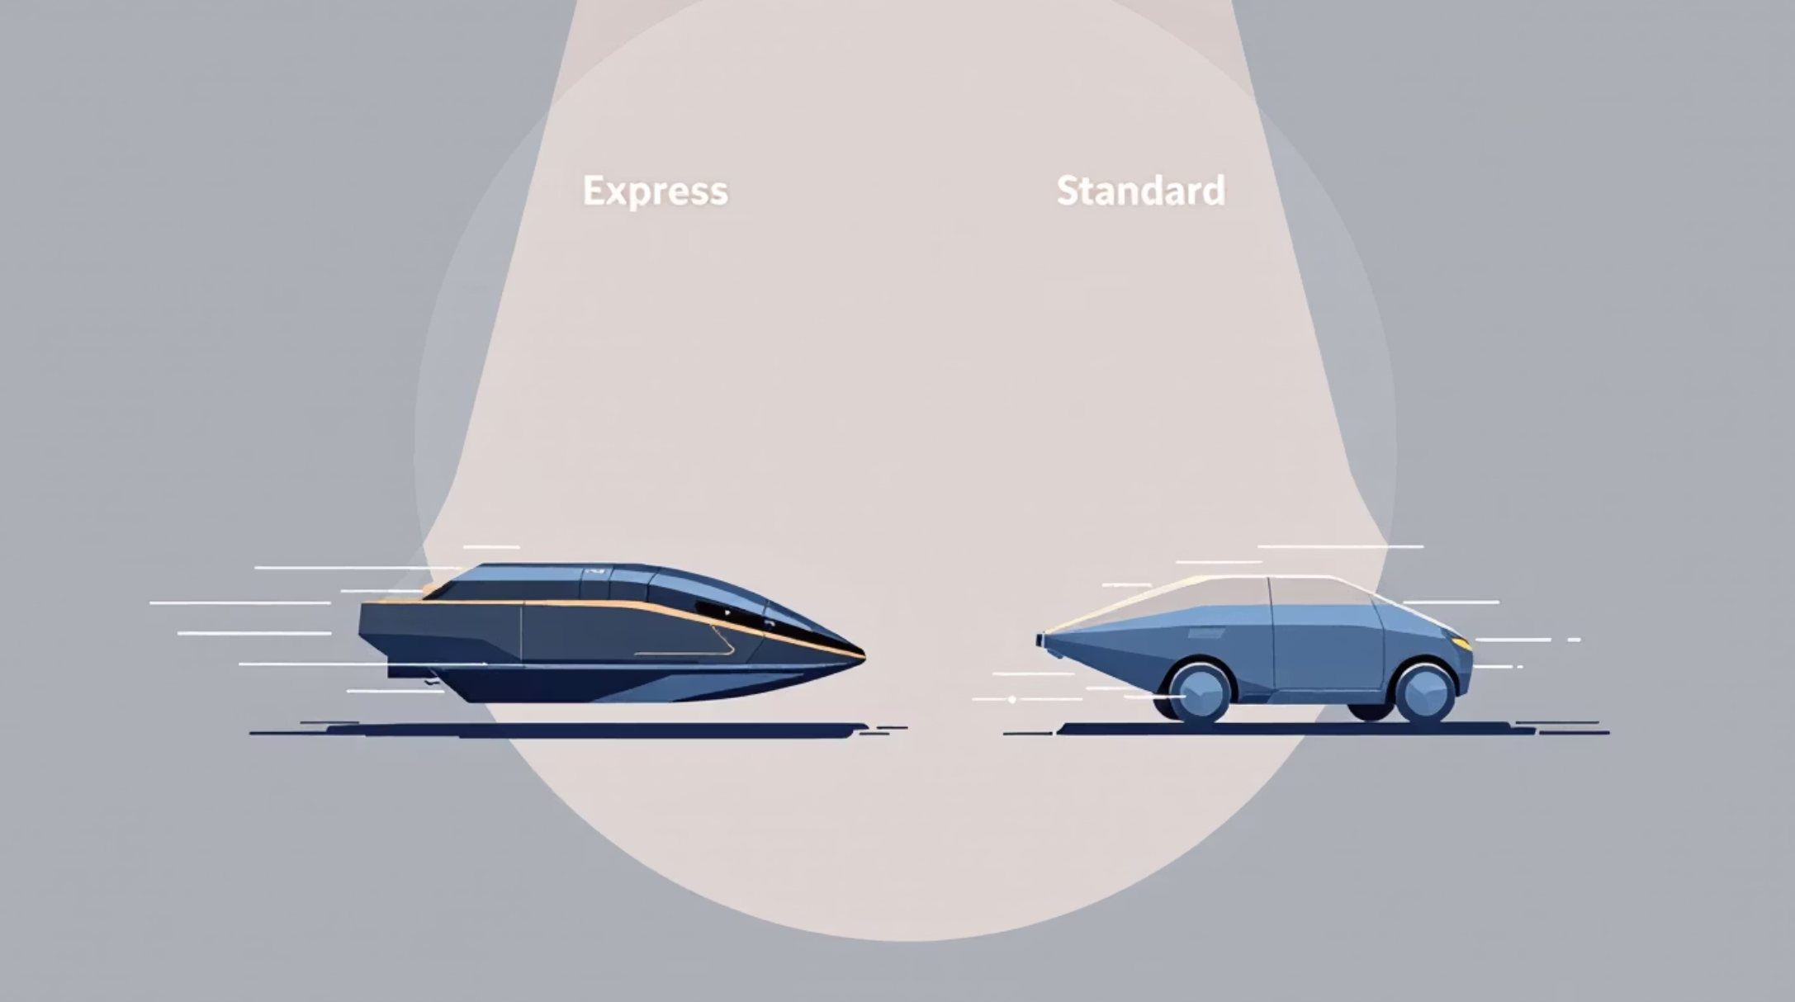
Shipping & Price
Express avg: 60.48 · Standard avg: 58.46
Implication
Express users spend slightly more — target for promotions

Slide 8
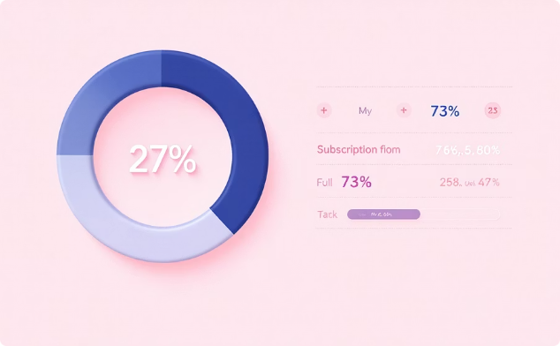
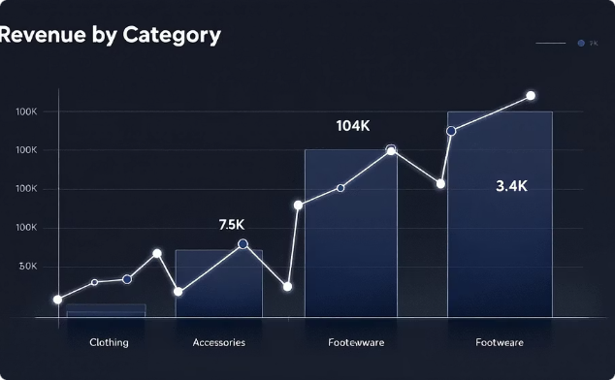
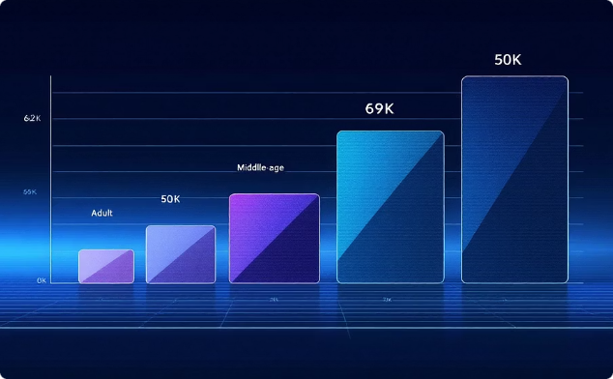
Dashboard Highlights (Power BI)
Subscriptions
Revenue by Category
Revenue by Age
Yes 27% · No 73%
Clothing leads (104K)
Young Adult top contributor

Slide 9

Customer Segments
Loyal
Returning
3,116 customers
701 customers
New
83 customers
Repeat buyers (>5 purchases): 958

Slide 10
Business Recommendations
Boost Subscriptions
Loyalty Programs
Review Discount Policy
Promote exclusive subscriber benefits
Reward repeat buyers to increase loyalty
Balance uplift with margin control
Product Positioning
Targeted Marketing
Feature top-rated, best-selling items
Focus on high-revenue age groups & express-shipping users

